Slide 1

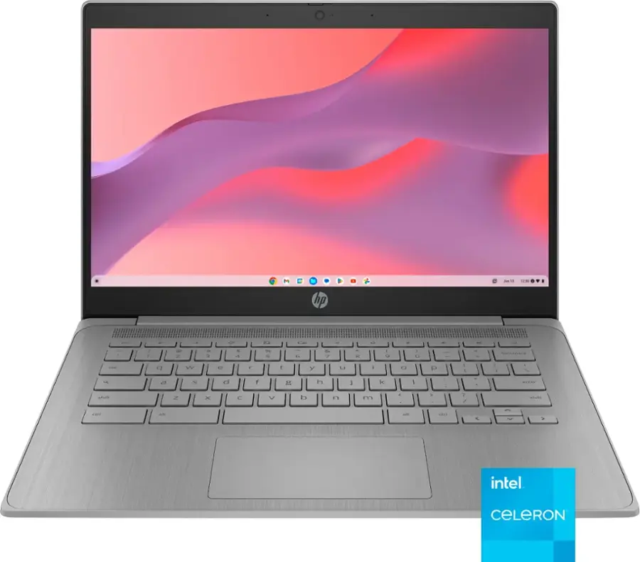


What Are People Saying About This Product?
Created by Sentiview AI

Slide 2




Get to Know the Product
HP - 14" Chromebook - Intel Celeron - 4GB Memory - 64GB eMMC - Modern Grey
Background is the part of a presentation that explains the context or history behind the topic being discussed. It includes relevant information to understand why the topic is important or relevant.

Slide 3

Quick Product Summary
Recommendation
Average Rating
Total Review
Price
92%
4.8/5
1,083
$1,299.99

Slide 4


How Do People Feel?"
Top Pros
Great TV, picture quality .....
Top Cons
complaints, different tv .....

Slide 5


What Customers Are Saying
“A beautiful picture, slim and sturdy design...”
“A beautiful picture, slim and sturdy design...”
— KenB ★★★★★
— KenB ★★★★★

Slide 6
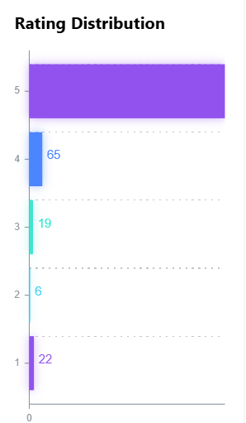

Rating Distribution
The majority of users are very satisfied. This product is considered highly satisfactory.
Ratings 5 and 4 are the highest. Most users are consistently satisfied with the product's quality.
The rating distribution is skewed toward the high end. The product is considered very good by many users.

Slide 7
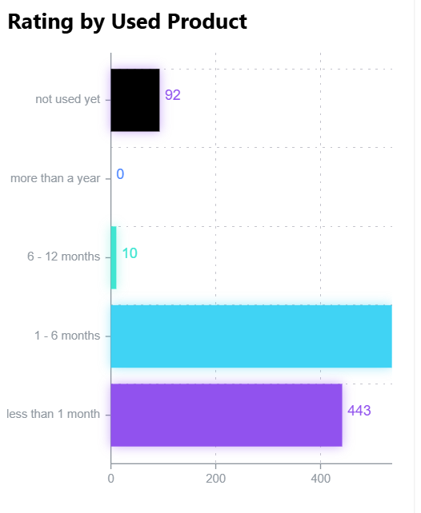
Rating by
Used Product
The majority of users are very satisfied. This product is considered highly satisfactory.
Ratings 5 and 4 are the highest. Most users are consistently satisfied with the product's quality.
The rating distribution is skewed toward the high end. The product is considered very good by many users.

Slide 8
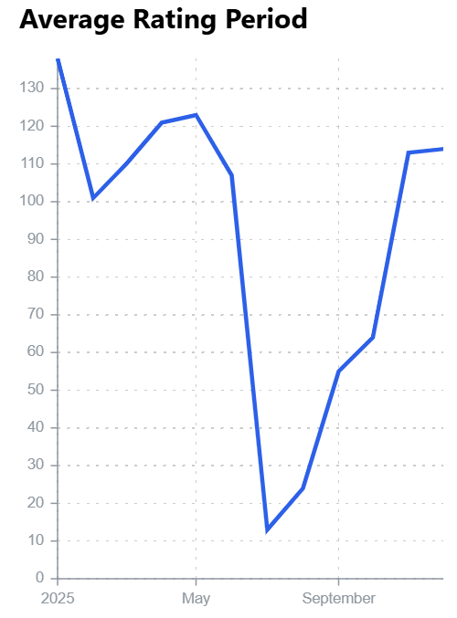
Average
Rating Period
The majority of users are very satisfied. This product is considered highly satisfactory.
Ratings 5 and 4 are the highest. Most users are consistently satisfied with the product's quality.
The rating distribution is skewed toward the high end. The product is considered very good by many users.

Slide 9
Conclusion

Slide 10

THANK YOU
Created by Sentiview AI

